Slide 1
Welcome to Mrs. Wolfe’s Class

Slide 2
Daily and Weekly Schedule
** Art Space – Wed. 8:45- 9:45 (1st Trimester)
** Dance – Wed. 10:45-11:30 (1st Trimester)
 | Monday | Tuesday | Wednesday | Thursday | Friday
8:45-10:30 | Language Arts | Language Arts | Language Arts | Language Arts | Science Friday/ Testing
10:30-10:45 | Recess | Recess | Recess | Recess | Recess
10:45-11:45 | Writing | Writing | Writing | Writing | Math
11:45-12:20 | Recess/Lunch | Recess/Lunch | Recess/Lunch | Recess/Lunch | Recess/Lunch
12:20-2:00 | P.E. / Math | Math | Math | Lab / Math | Early out 1:15
2:00-2:15 | Recess | Recess | Recess | Recess
2:30-3:15 | Music | Library | Science or Social Studies | Science or Social Studies

Slide 3
Morning Routine
Morning Routine fosters independence, and reinforcement of concepts (spelling, grammar, math).
Small Groups meet with teacher and other volunteers during this time.
      Routine
Read and Record
Prof Reading
Scratch Pad
Spelling
Seven Up Sentences

Slide 4
Second Grade Learning Guide
Language Arts
Read words with long and short vowels, common vowel teams, two-syllable words. And understand the meaning of words formed when common suffixes are added.
Produce, expand and rearrange sentences to add interest and provide meaning to writing.
Ask and answer questions about a text and pay close attention to details including pictures and graphics, and in stories and books to answer who, what, where, when, why, and how questions.
Identify main ideas in informational text and use text features to locate key facts or information efficiently.
Determine the lesson or moral of stories, fables, and folktales,
Retell key information or ideas from media or book read aloud.
Write stories that include a clear beginning, middle and end provide a short sequence of events.
Participate in shared research projects using a variety of books on a single topic to produce a report.
Take part in conversations by linking his or her comments to the remarks of others a nd asking and answering questions to gather information or depend their understanding of the topic.

Slide 5
Second Grade Learning Guide
Mathematics
Extend their understanding of our base-ten number system to the thousands place.
Count by fives, tens, and hundreds beginning at any number.
Use mental strategies to fluently add and subtract within 20, and know from memory all sums of two one digit numbers.
Solve addition and subtraction problems using a variety of models and drawing within 1,000.
Use appropriate tools to measure lengths in inches and centimeters. Estimate length using inches, feet, centimeter, and meters. Relate addition and subtraction to length.
Describe and analyze shapes by examining their sides, faces and angles.
Partition circles and rectangles into tow, three, or four equal shares and describe the shares as halves, thirds, a third of, etc.

Slide 6
Second Grade Learning Guide
Science
Engaging in scientific practices and communicating scientific concepts.
Learning about rocks, space, and weather.
Investigating the effects of gravity.
Examining how changes to a system can affects various materials.
Identify the needs of living things and how animals have adapted to survive.

Slide 7
Second Grade Learning Guide
Social Studies
Recognize and describe how people within their community, state and nation are both similar.
Recognize and practice civic responsibility and demonstrate good citizenship.
Use geographic tools and skills to locate and describe places on earth.
Explain the difference between consumers and producers and the different types of goods and services that help people to meet their needs.

Slide 8

Language Arts
Read Alouds
Writing
  Journal Writing
  Narrative
  Informational
  Opinion
Vocabulary
  Text Talk
Wonders Reading Program
  Thematic
  Skill Building
  Spelling
  Comprehension
Lexia

Slide 9

Math
Eureka Math
  Eight Modules
  Sprints
  Application Problems
  Concept Development
  Debrief
  Math Journals

Slide 10

Science
Scientist of the Week
Hands on Science – Monthly
Units
  Rocks
  Space
  Weather
  Forces
  Living Things
    Plants
    Animals
Scientific Practices
Communicating Scientific Concepts

Slide 11

Social Studies
Culture
Citizenship
Geography
Economics
  Junior Achievement
    Volunteer Needed

Slide 12

Assessment
Teacher Observation/ Anecdotal
Weekly Language Arts/ Spelling Tests
Math/ Exit Tickets / Module Tests / Sprints
All Tests will go Home for Parents to see Progress or Problem Areas.
S.E.P. / Parent Teacher Conferences → Twice a Year and or as needed.

Slide 13

Homework
Weekly
Goes home Monday
Due the following Monday
Reading minutes

Slide 14
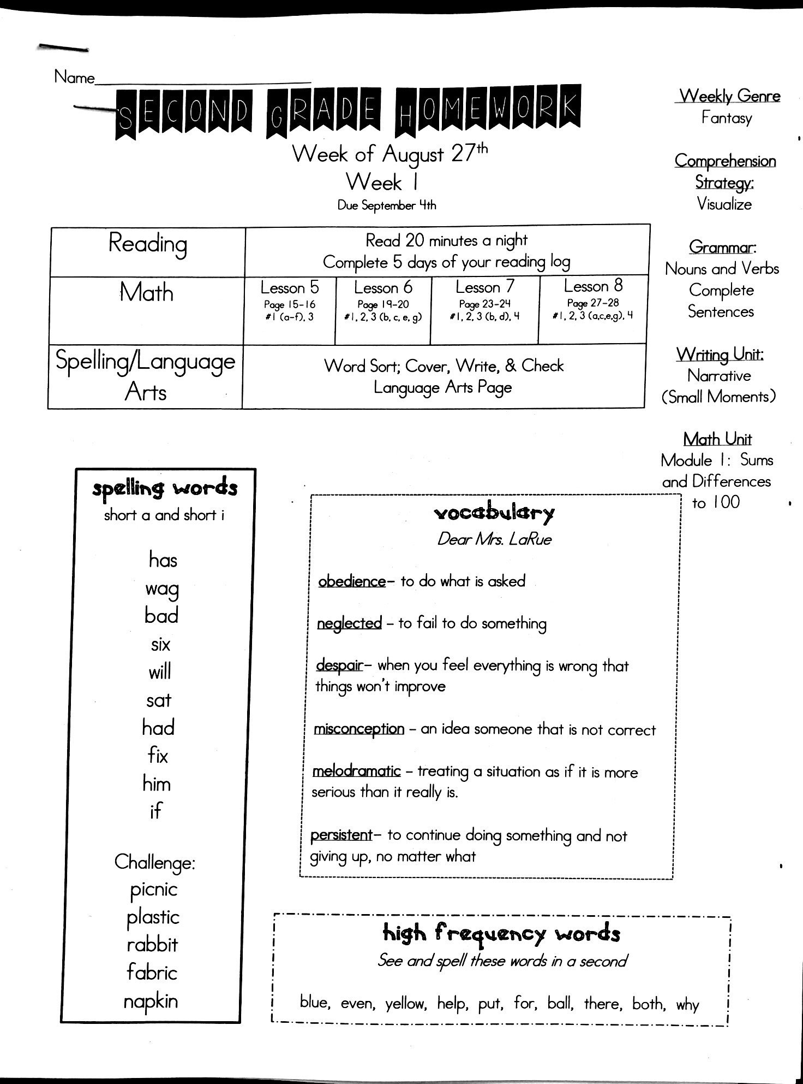

Slide 15
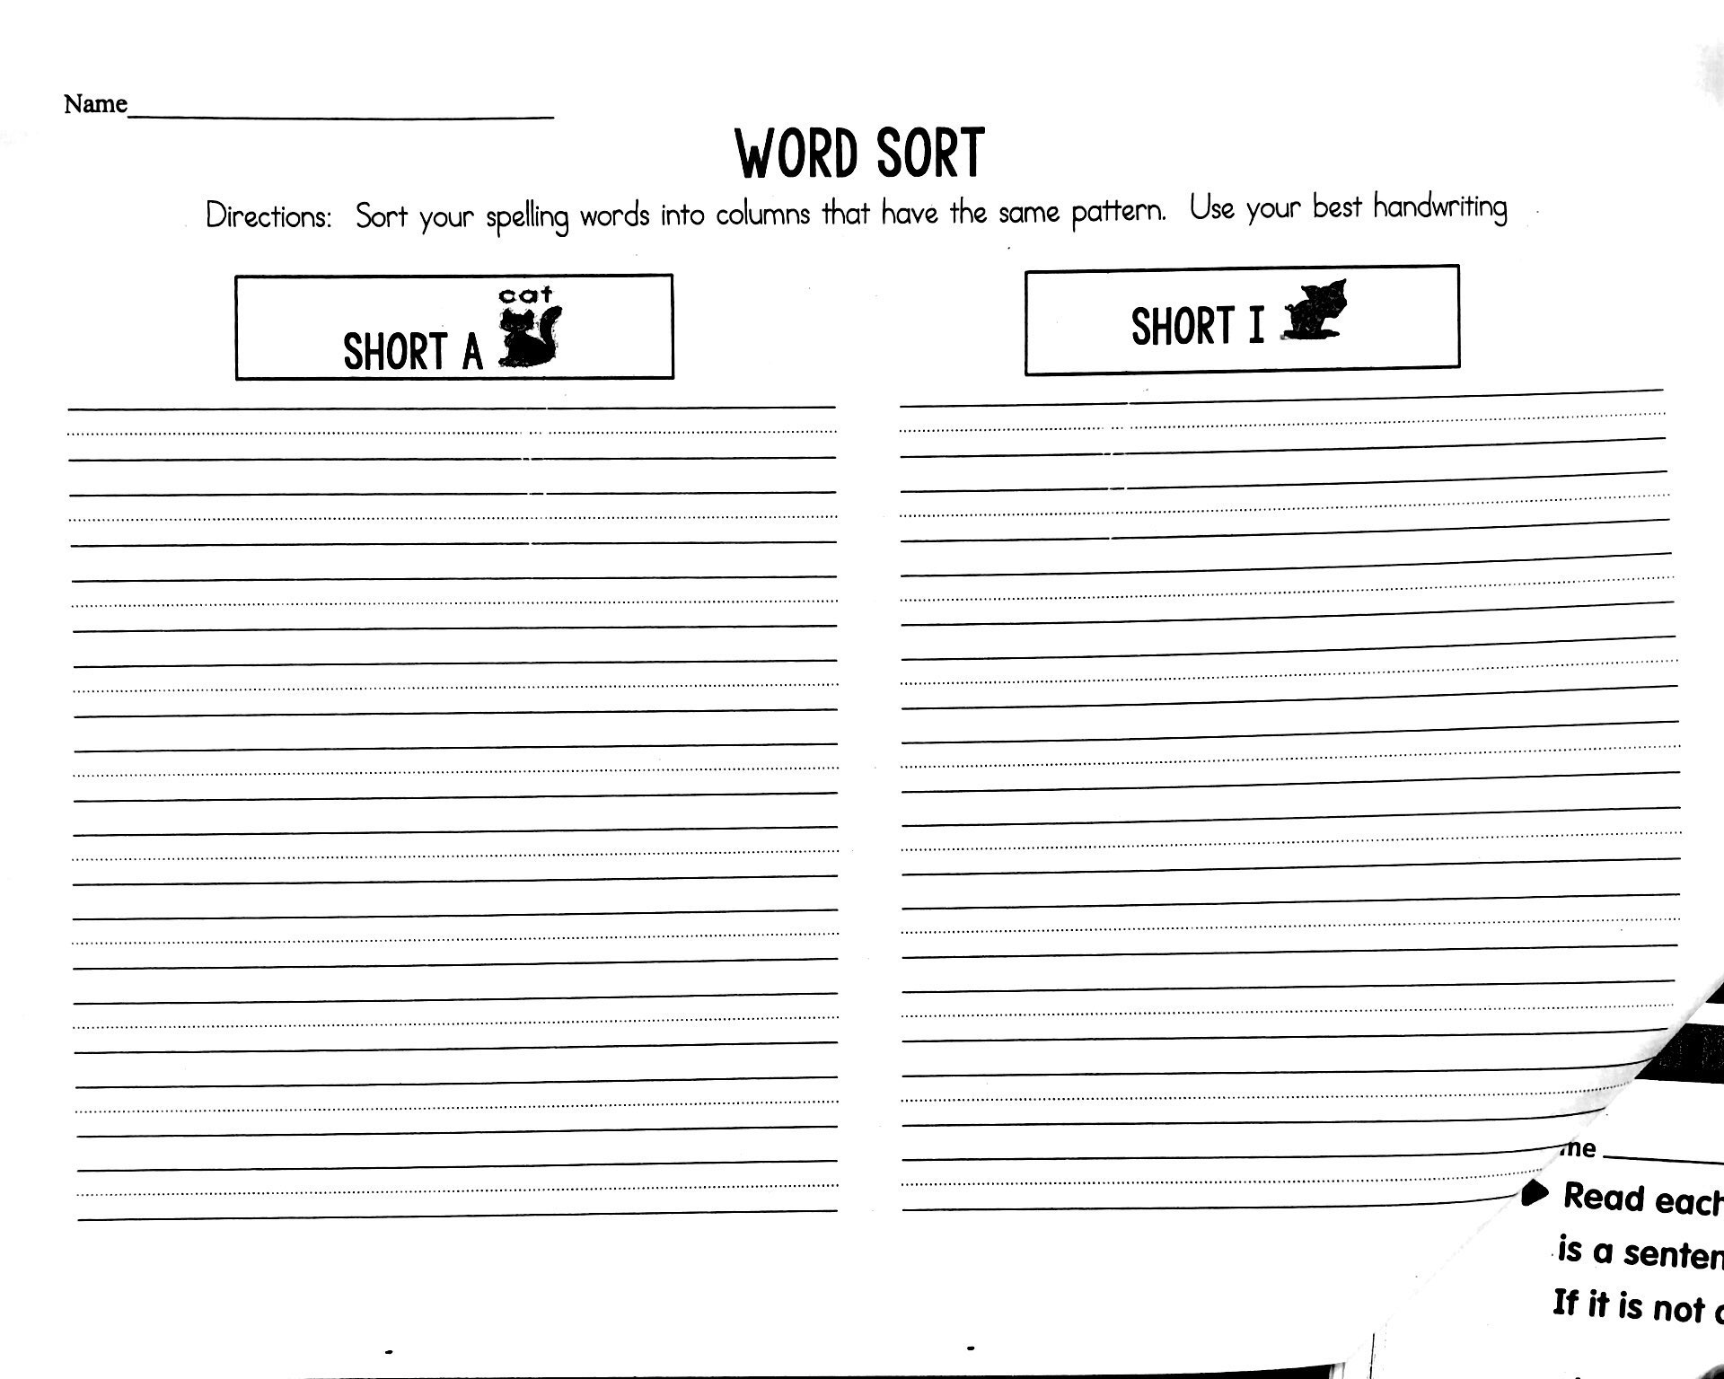

Slide 16
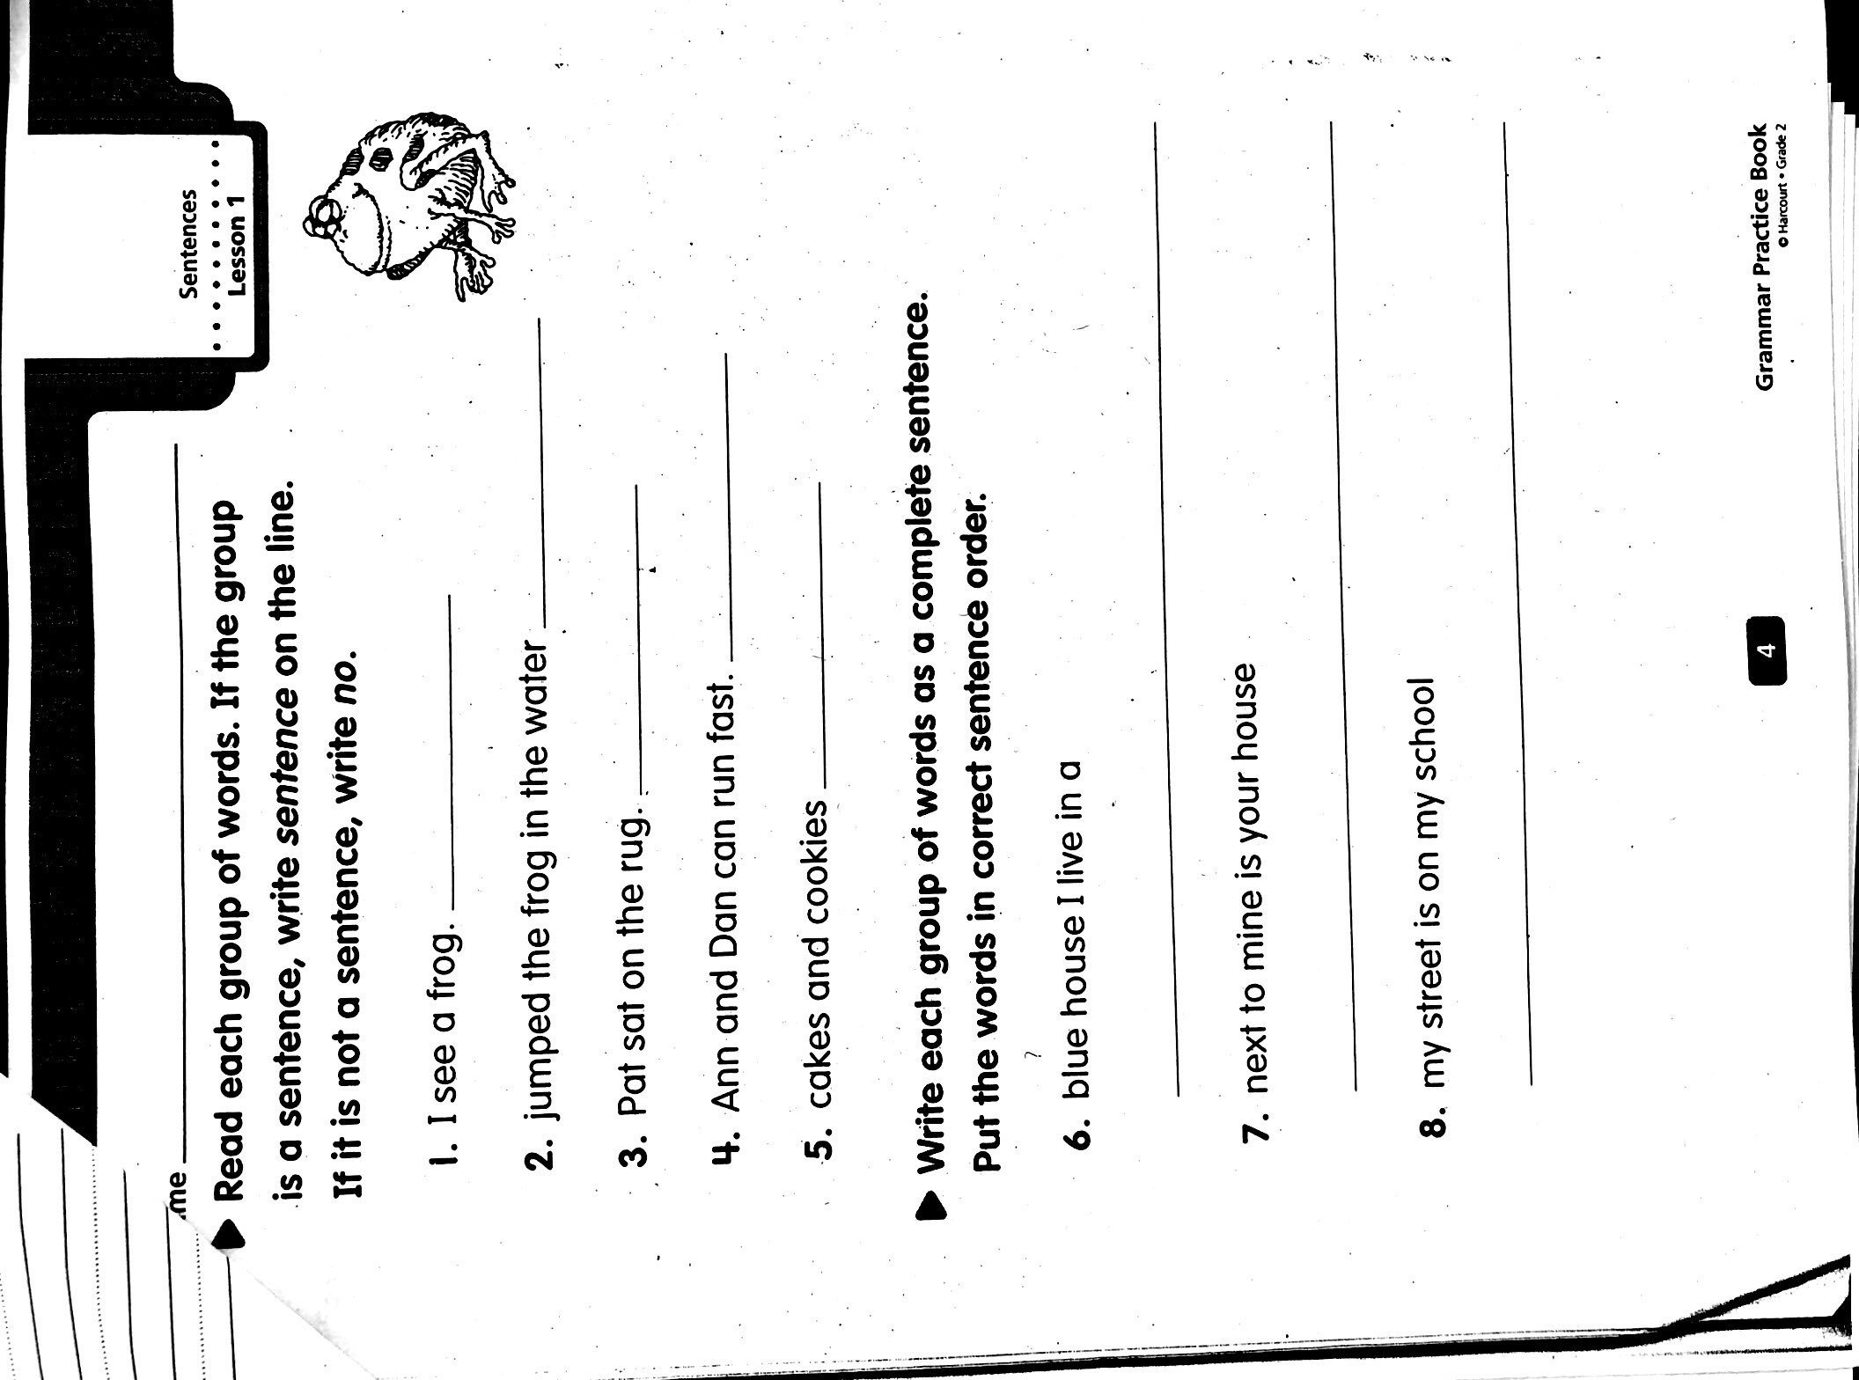
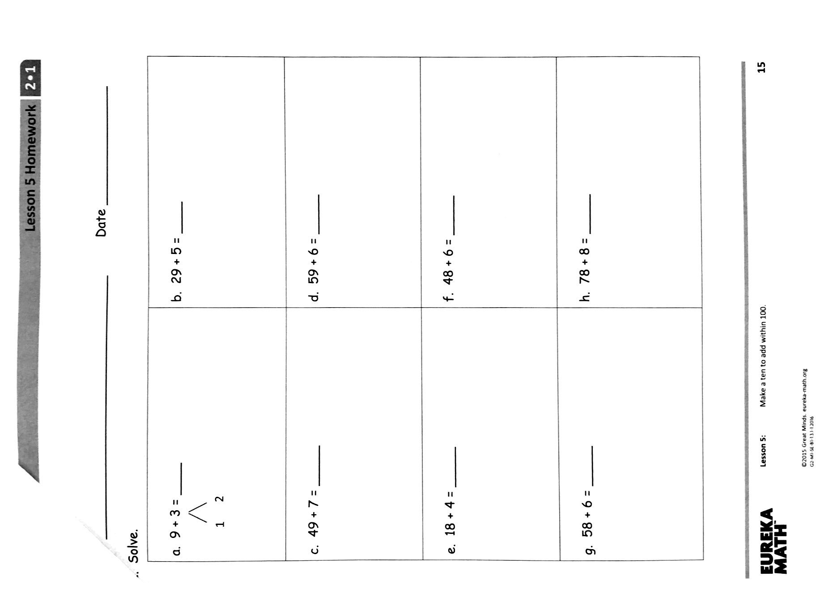

Slide 17
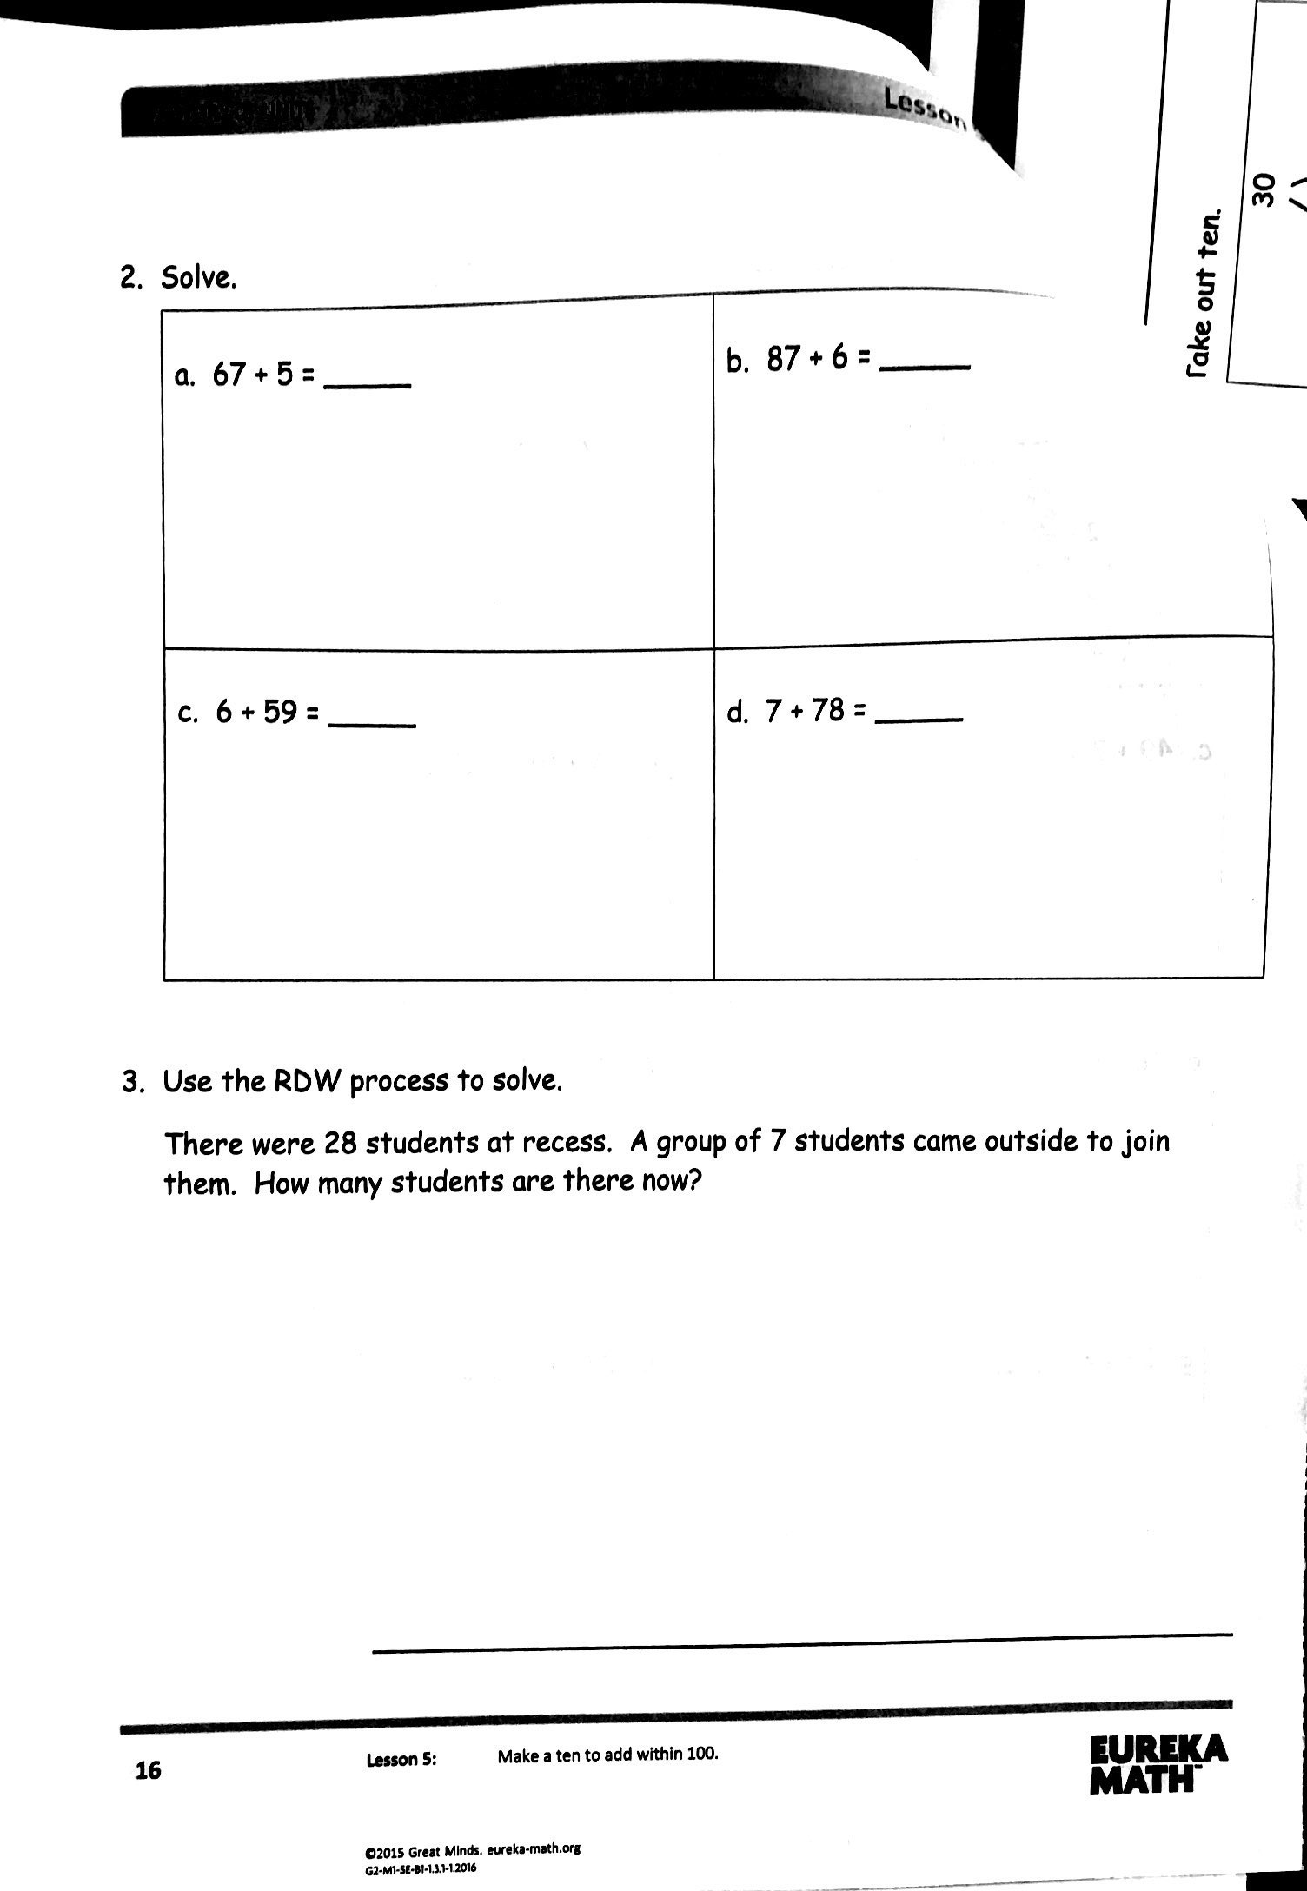
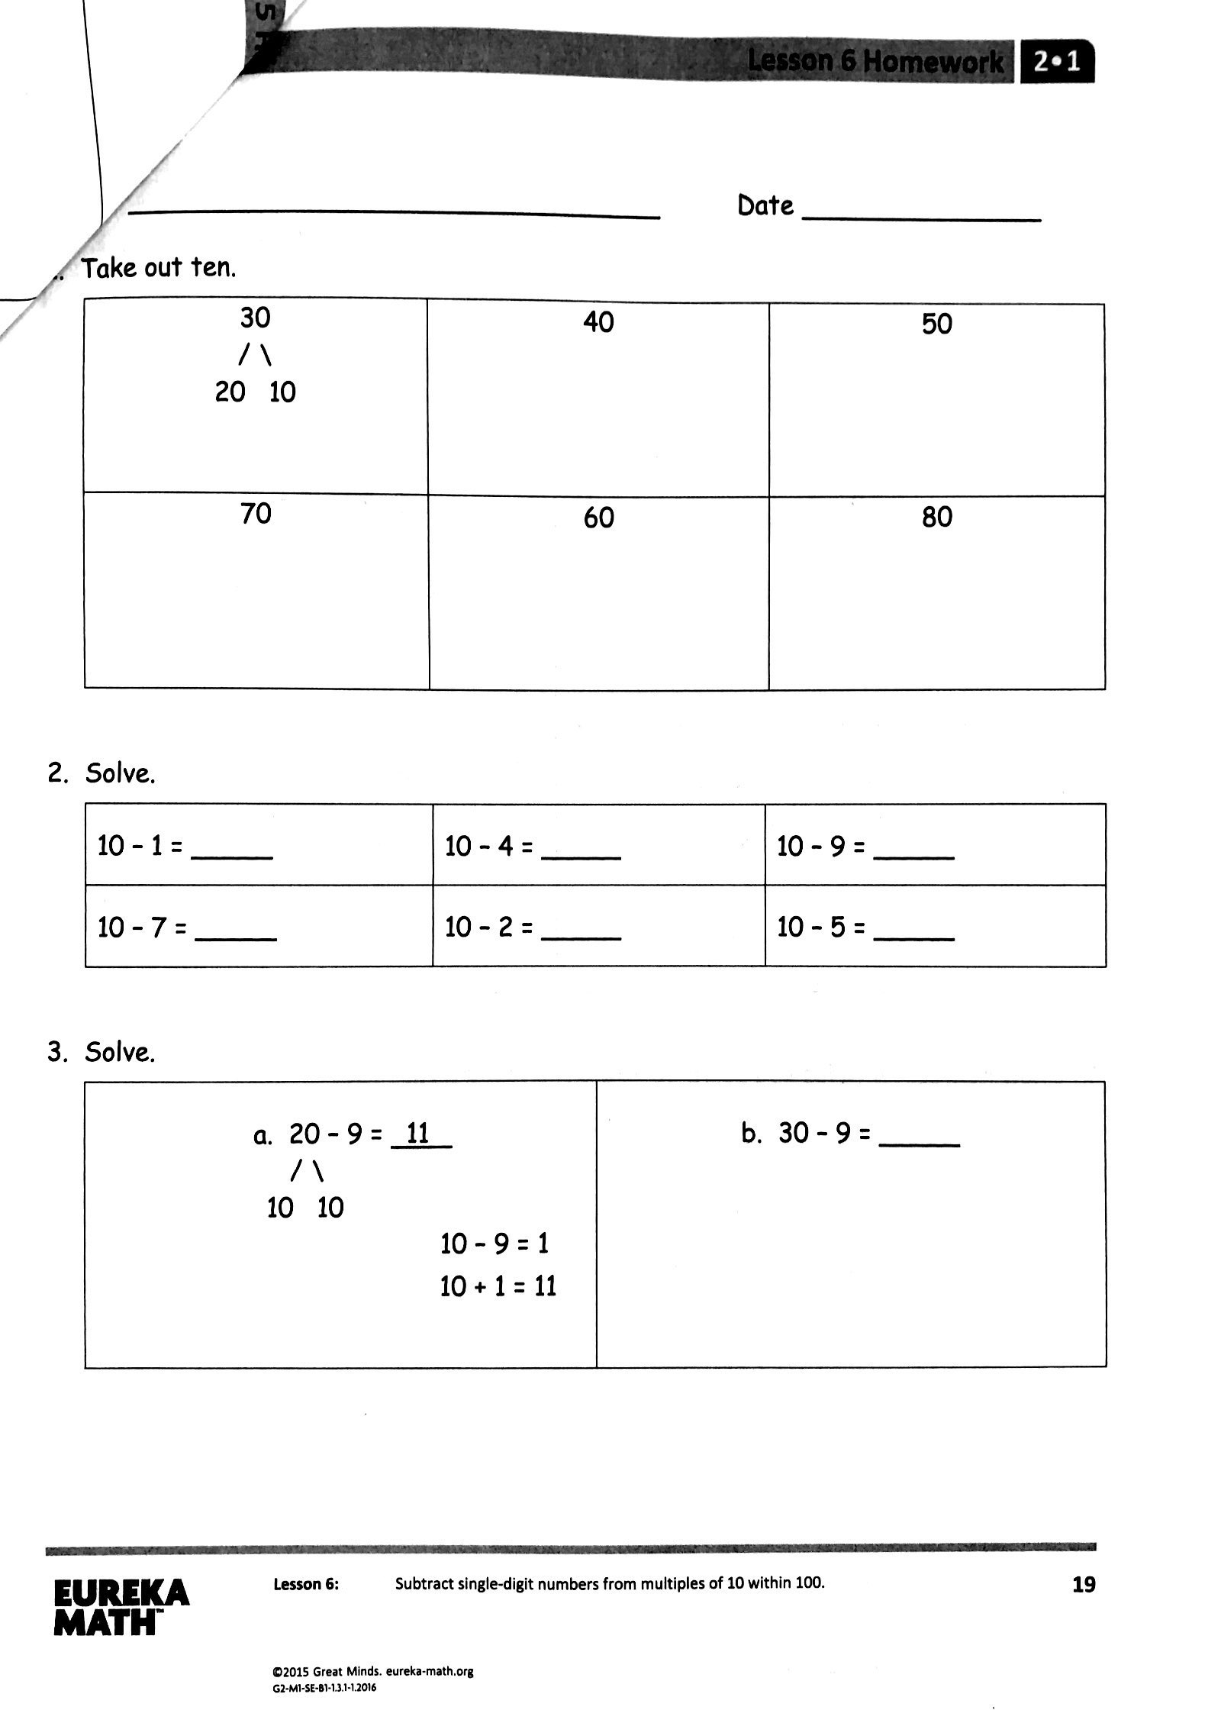
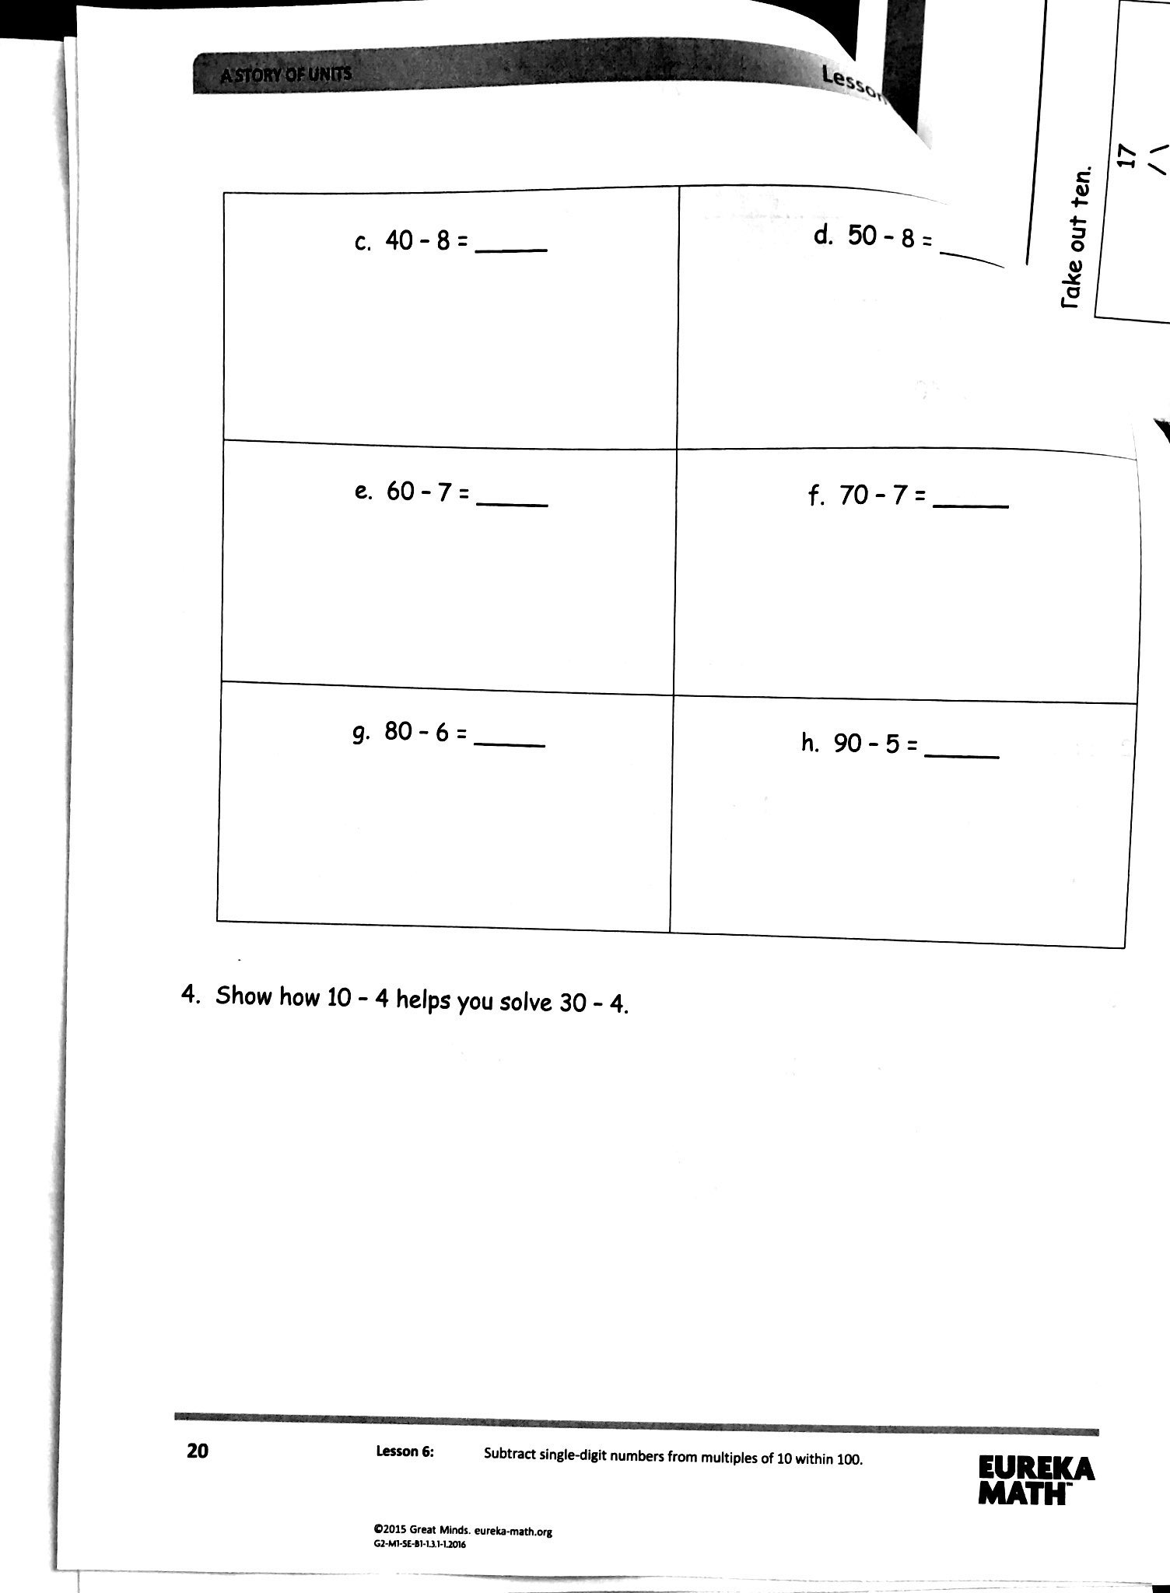

Slide 18
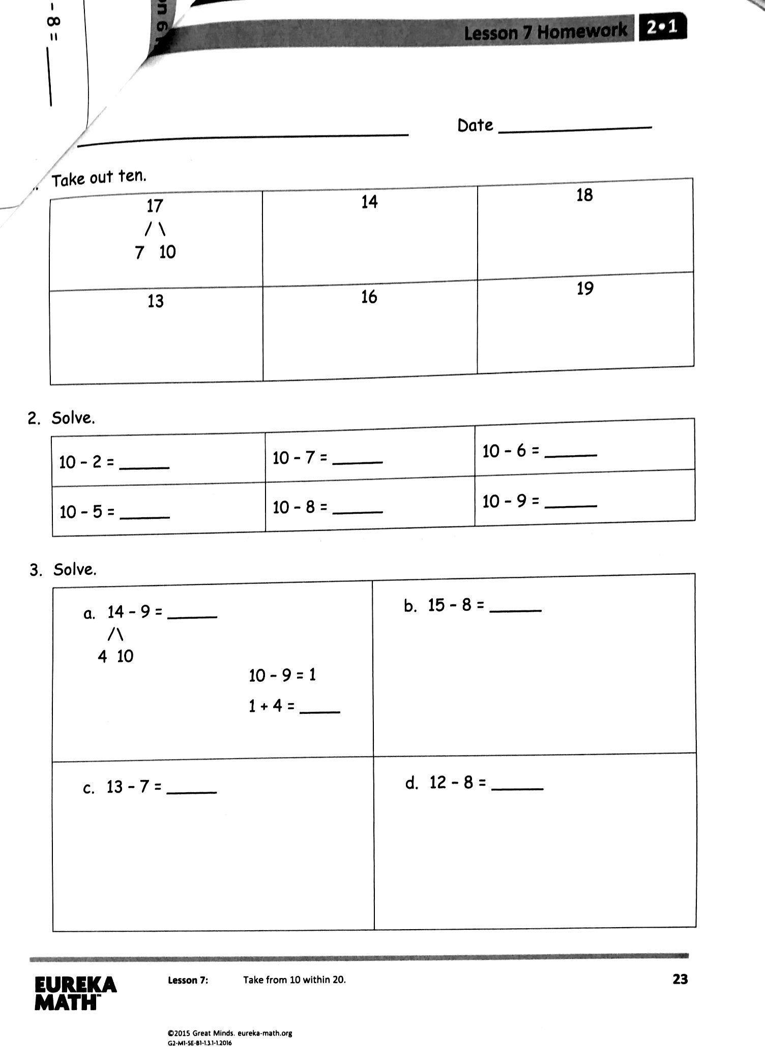
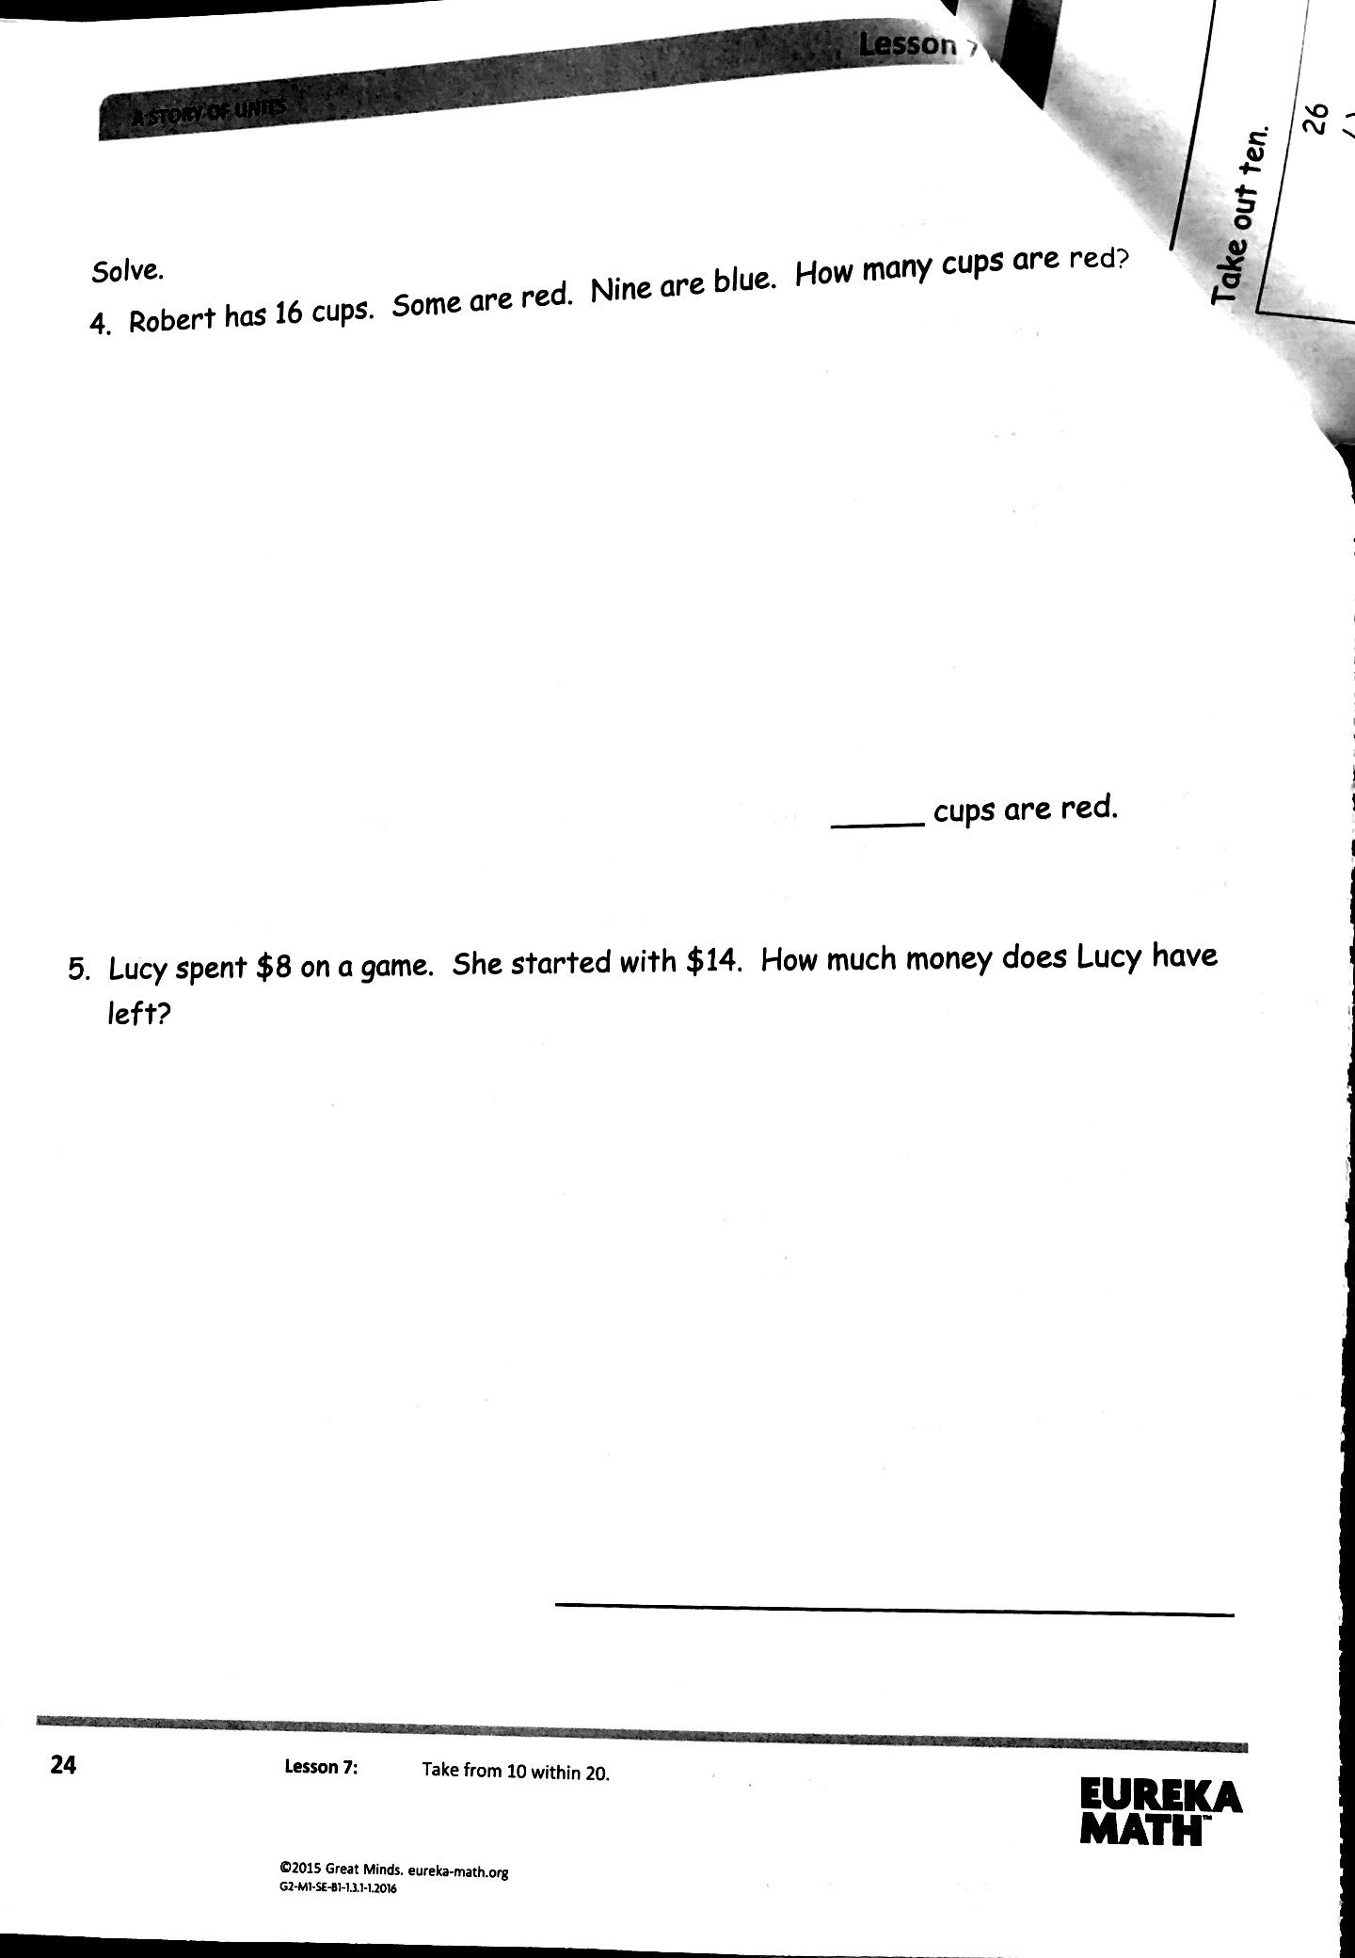

Slide 19
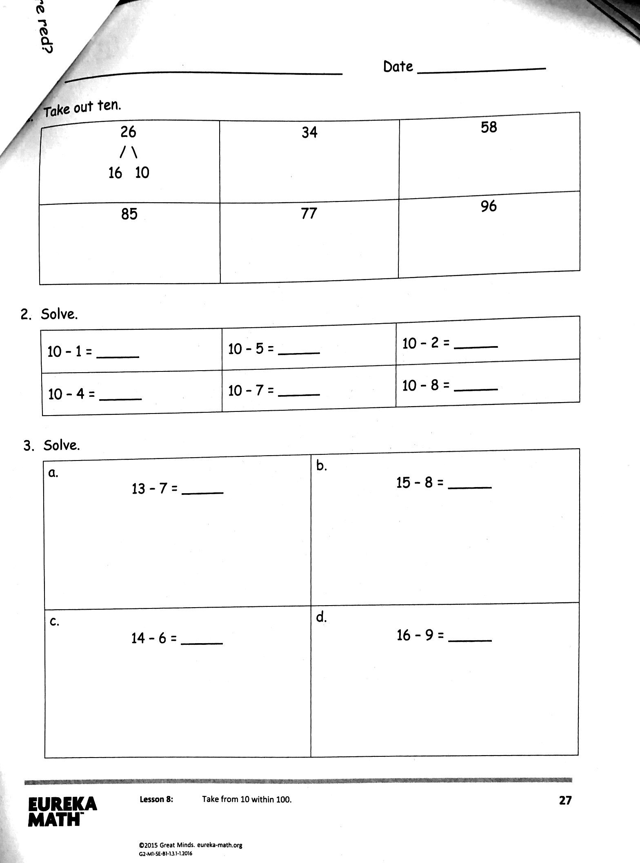
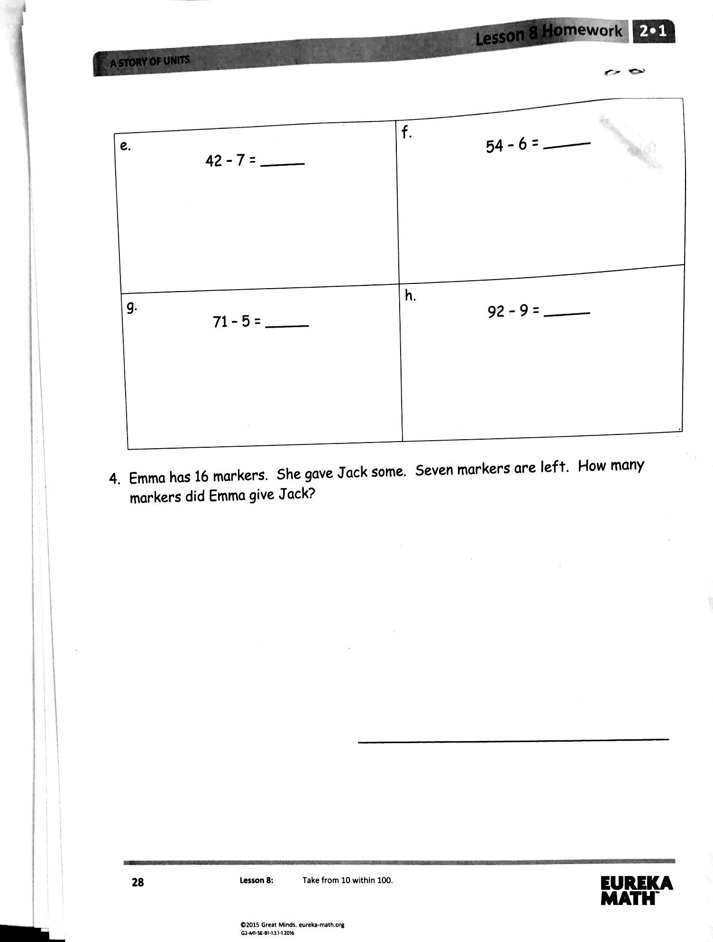

Slide 20

I am so excited to work with your children this year. Feel free to email me with any questions, comments, concerns.

